Slide 1

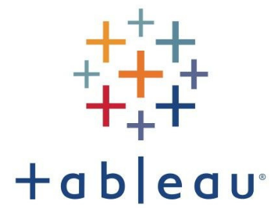



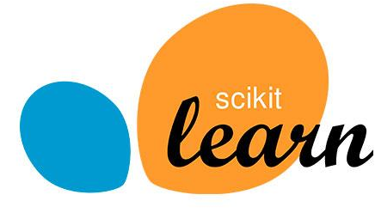


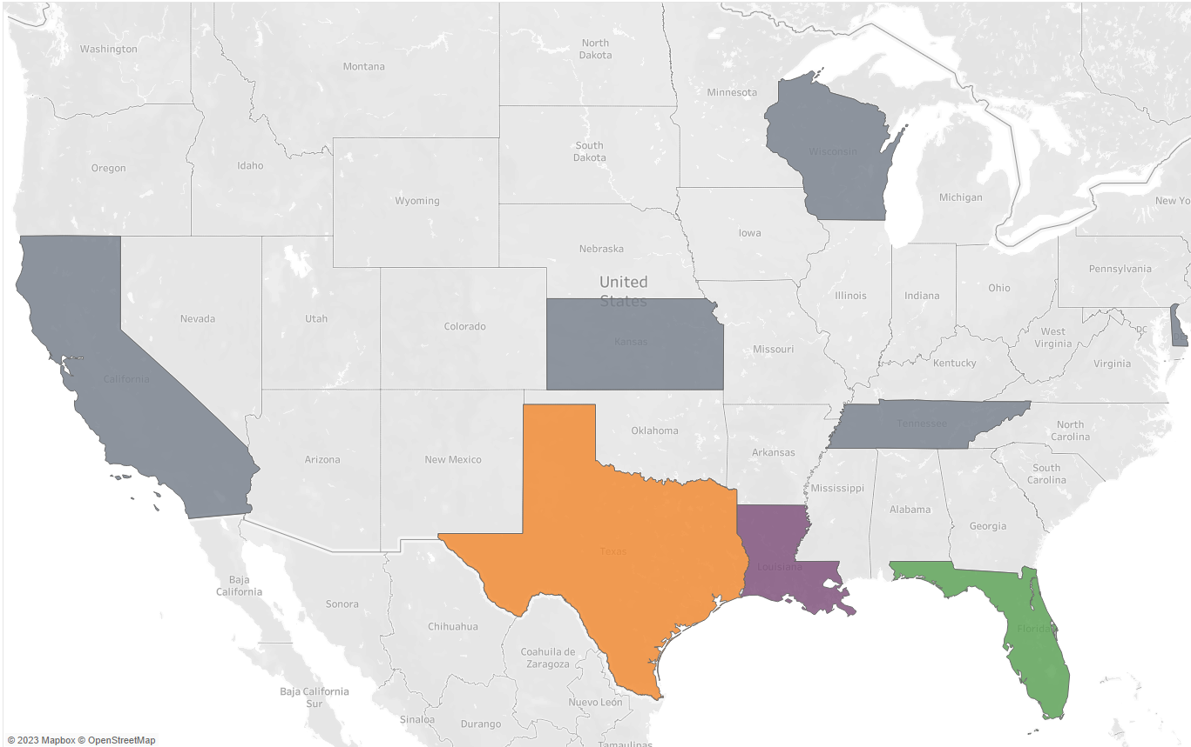
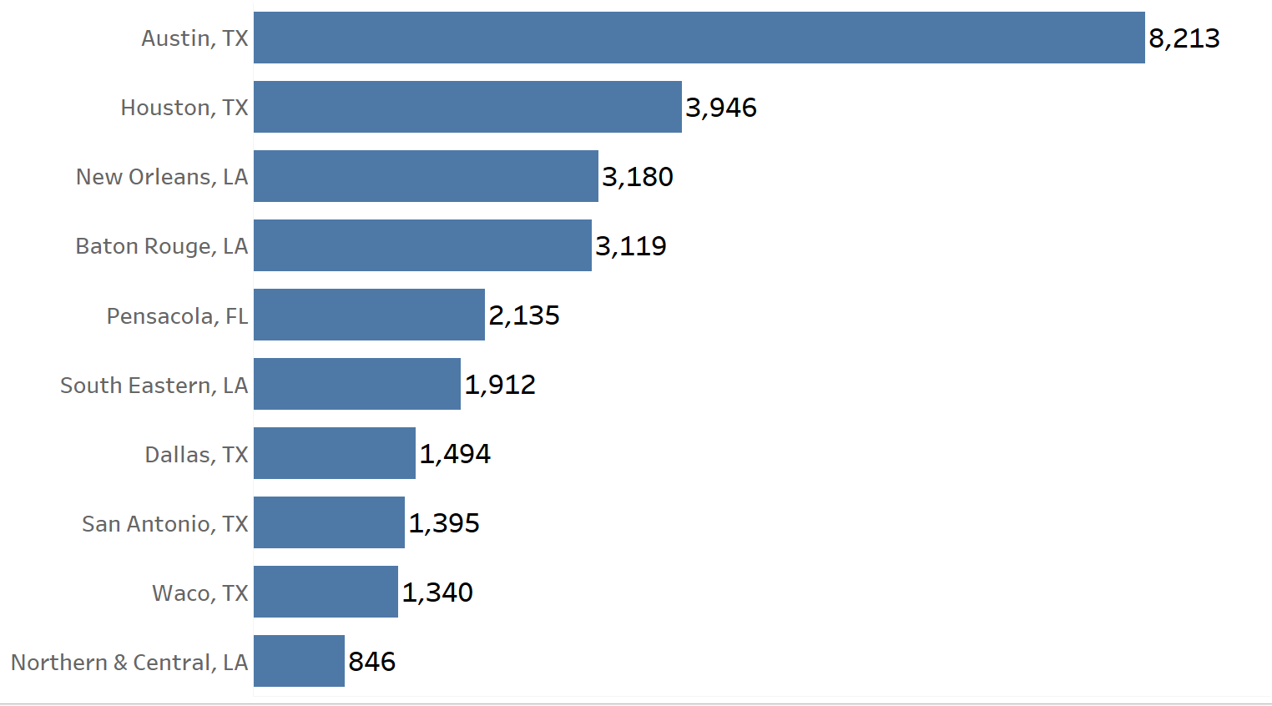
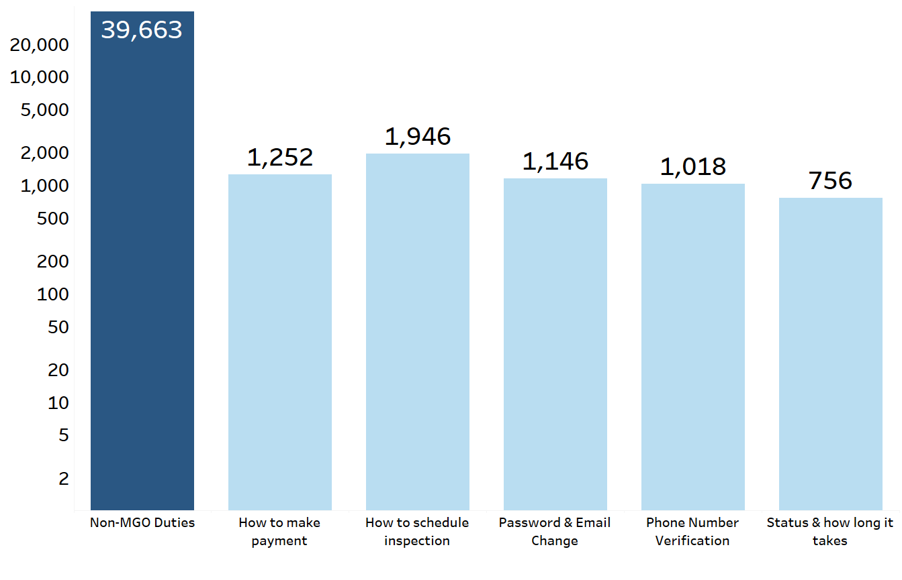
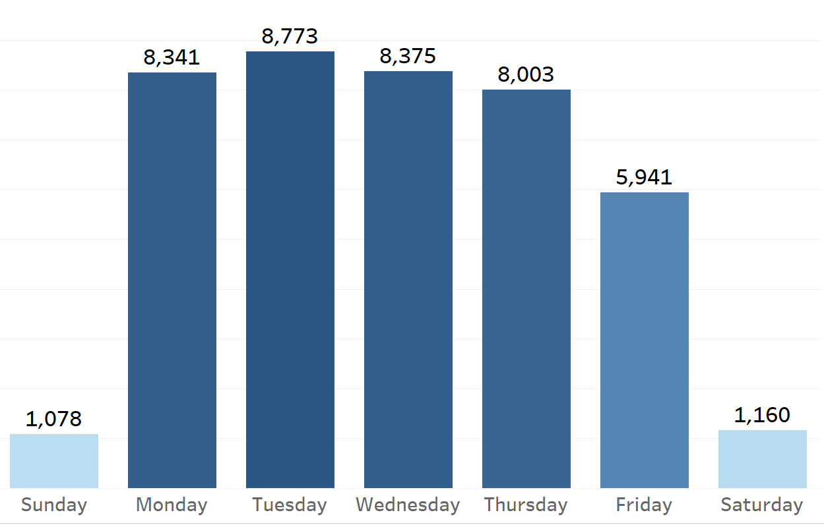
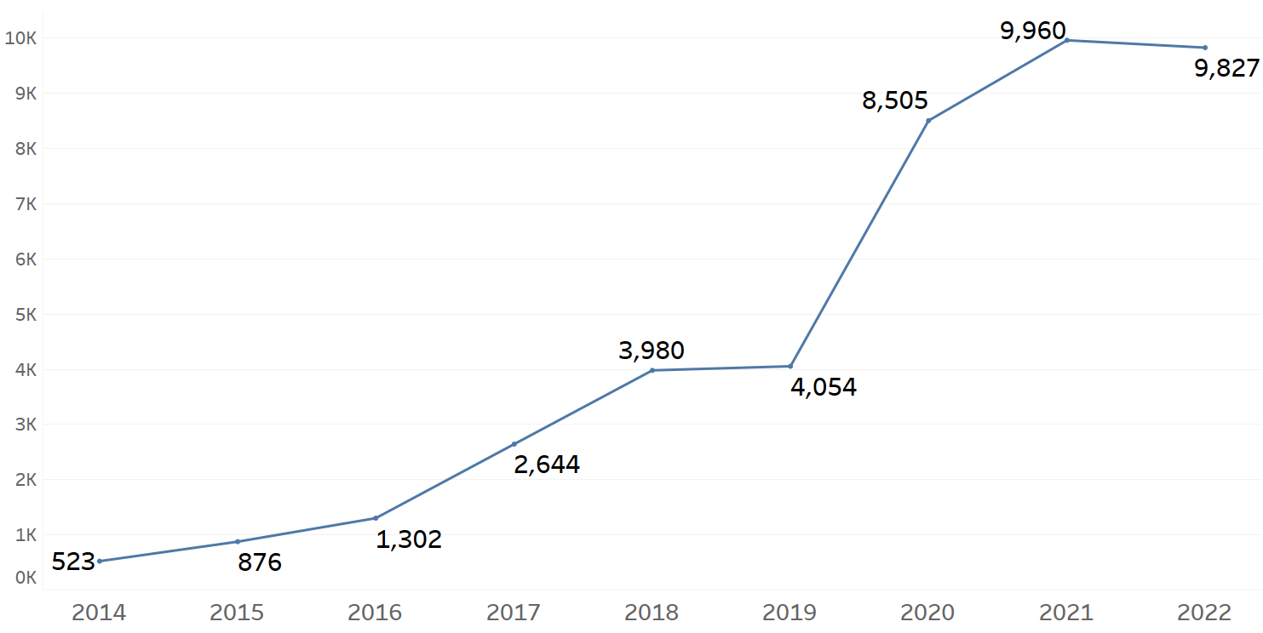
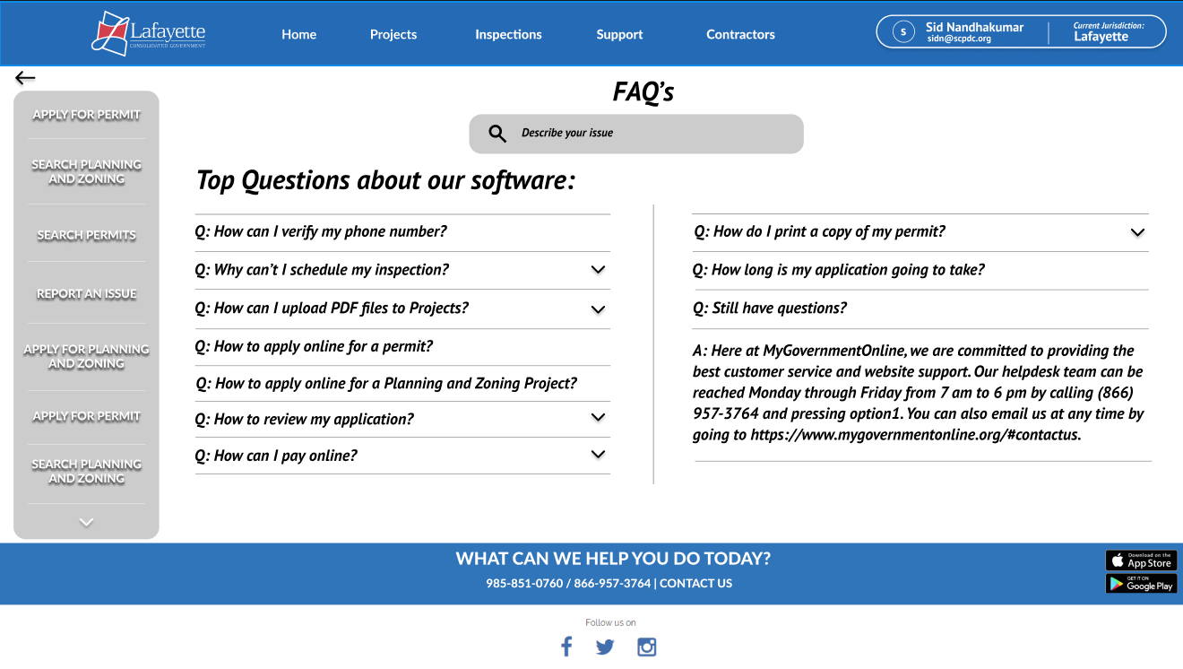
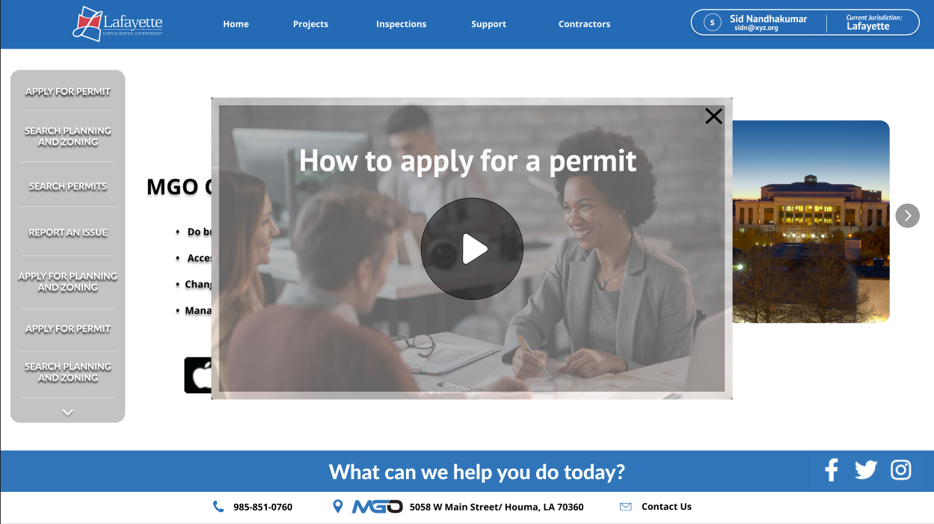

How Data Science and Machine Learning is helping Local Businesses
Saisiddharth Nandhakumar, Dr. En Mao, College of Business Administration
Introduction
Methodology
In this study, we analyze why MyGovernmentOnline (MGO), a local Houma, LA permitting software company is receiving a large number of customer tickets from their 80 jurisdictions around the country. We extracted all their customer ticket data from 2014 to 2022, which had information on the customer problem descriptions, when tickets were creation, and ticket completion date. Currently, there is a high level of staff turnover rate due to stress from handling frustrated customers.
The main objective is:
What are the main issues customers are facing?
How can we improve the process of resolving customer tickets?
Data Collection
Data Cleaning
Data Preparation
Data Analysis
93,967 customer tickets over 9 years through Jira API
Downloaded 100 individual ‘.csv’ files due to bug in Jira API
Used a programming language called python to speed up the process of collection which normally would take too long manually
Lots of variables with irrelevant data
Identified and removed inaccurate data from records (E.g. Tickets that took over 900 days to complete)
Cleaned description column which had many special characters (@,$,%,*,!,?), hyperlinks, names, and phone numbers.
Out of 93,967 rows of data only 41,751 were customer tickets. 52,216 were tickets for communication with other jurisdictions
Converted date and time columns to proper date-time format.
Due to jurisdiction not being recorded in most tickets, used phone number to map the tickets to where they were calling from.
Using Tableau, we visualized the following findings:
Discovered where our customers are from
What problems are our customers facing?
What’s our busiest day of the week?
How have support tickets grown?
Using BERTopic and Scikit-Learn, we analyzed the key topics of customer tickets.
Machine Learning
Python Code Snippets
Machine Learning is the science of getting computers to learn without being explicitly programmed. In this study, we use a subset of machine learning called deep learning. Deep learning are machine learning algorithms based on the structure of neurons in the brain which has the capacity to learn complex patterns from data.
In analyzing the descriptions of customer problems, we use a deep learning algorithm known as BERTopic, which performs a function called Topic modelling to categorize customer problems into specific categories.
It does this by separating each individual word from each customer ticket, and finding various relationships different tickets may have with each other.
Where are our customers from?
What problems are our customers facing?
15% of all tickets can be grouped into the following 5 categories.
The largest “Non-MGO Duties” refer to tickets that fall out of the business scope of MGO. That’s a lot of wasted hours!
This chart shows where the top 10 markets by city are distributed among the top three states:
Texas
Louisiana
Florida
16,982
9,647
2,135
Tools
We can see our top 3 states by customer tickets shown on the map.
The primary tools used for this project include Python, R, Tableau, Excel, AWS Sagemaker studio, and IBM Quantum Lab.
This also includes several machine learning libraries such as
Scikit-learn
BERTopic
What is our busiest day of the week?
How have support tickets grown over the years?
Tuesday is our busiest weekday.
Monday – Thursday MGO received more than 8,000 tickets.
Friday has the lowest tickets.
This data can be used to determine the number of staff that they need during the week.
Service Learning
See here a sudden spike in tickets in 2020, which goes from 4054 to 8505, more than doubled in a year.
This project combined my academic coursework with community service to address community needs. It encouraged and challenged me to engage with and learn from real-world problems, while providing valuable services to my community.
From my project with MyGovernmentOnline I learned a lot about the field of data science and analytics and probably more than what I would’ve learned from any class, textbook, or online course. During the process of learning and implementing what I learned, Dr. Mao provided me with:
Different perspectives
Thinking processes
Approaches
Which I would’ve never thought of alone. This project gave me a deeper appreciation for the importance of communicating with stakeholders and working in a team setting. All together this was an invaluable experience.
Number
of
Customer Tickets
Customer tickets grew steadily from 2014 – 2019.
Three Key Business Recommendations
FAQs Mockup
Adding a FAQs page could help mitigate the number of customer tickets by answering most of the customers questions.
Clearly define what MGO can and cannot do for the customer.
Help Video Mockup
Short help videos to guide customers and improve their experience.
Could in turn reduce the number of tickets as well.
Staffing Strategies
Since majority of customer tickets are only on four days of the week. Employees could be given shorter work weeks or half workdays.
Happier employees
Less stress
Reduce Labor Costs
Increased employee morale

